Slide 1
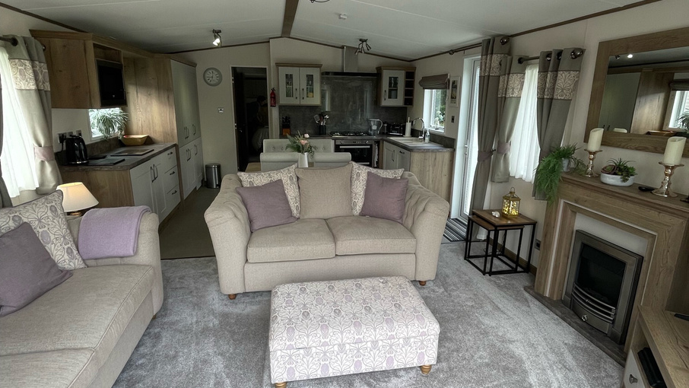
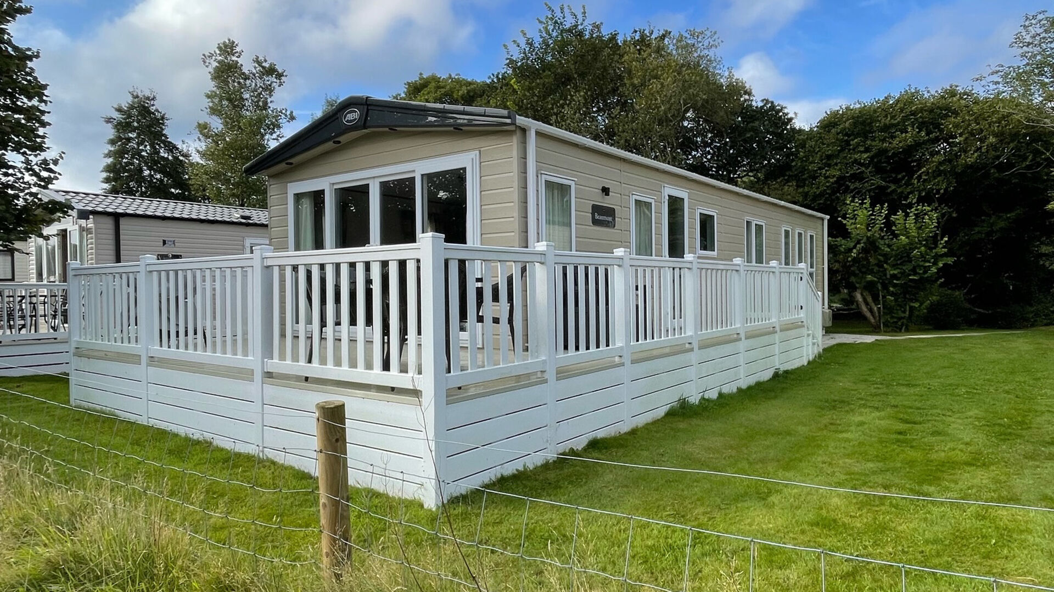
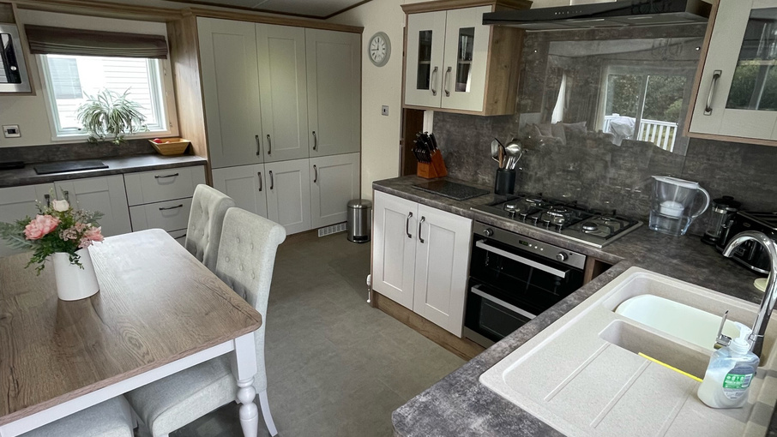
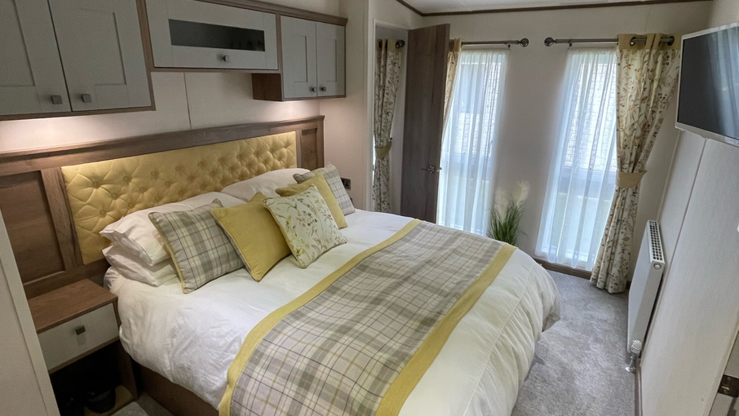
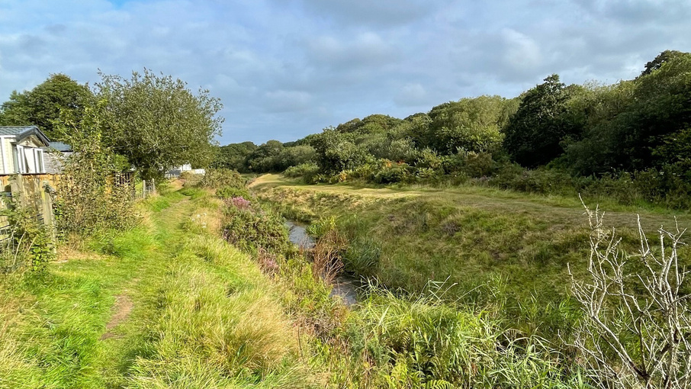
www.pennys.net
Black 1, River Valley Country Park, Relubbus, Penzance, Cornwall, TR20 9ER
GUIDE PRICE
£69,950
TENURE Leasehold
A Beautifully Presented And Spacious ABI 42 x 14 Beaumont Static Caravan Located Alongside The Beautiful River Hayle on A Peaceful Country Park In West Cornwall.
Open-Plan Lounge • Fully Fitted Kitchen/Diner •
Two Bedrooms (Master En-Suite Bathroom) • Separate Shower Room •
Spacious Decking • Allocated Parking • Residential Specification •
uPVC Double Glazing & Gas Central Heating •
Site Open For Eleven Months Of The Year. •
Pennys Estate Agents Limited for themselves and for the vendor of this property whose agents they are give notice that:- (1) These particulars do not constitute any part of an offer or a contract. (2) All statements contained in these particulars are made without responsibility on the part of Pennys Estate Agents Limited. (3) None of the statements contained in these particulars are to be relied upon as a statement or representation of fact. (4) Any intending purchaser must satisfy himself/herself by inspection or otherwise as to the correctness of each of the statements contained in these particulars. (5) The vendor does not make or give and neither do Pennys Estate Agents Limited nor any person in their employment has any authority to make or give any representation or warranty whatever in relation to this property.
PENNYS ESTATE AGENTS
2 Rolle House, Rolle Street, Exmouth, Devon, EX8 2SN
Tel: 01395 264111 EMail: help@pennys.net

Slide 2
Black 1, River Valley Country Park, Relubbus, Penzance Cornwall, TR20 9ER
Black 1 is located on the beautiful River Valley country park in West Cornwall and sited alongside the beautiful River Hayle. The site fees on the park are extremely competitive and the park is open for 11 months of the year.
Elegant, luxurious and spacious, the ABI Beaumont static caravan is the ultimate in holiday home design. As one of ABI’s top of the range caravans, the Beaumont comes equipped with all the essential features, plus additional luxuries and thoughtful touches throughout, as well as stunning contemporary furnishings and wooden accents.
With a bright, modern open plan living room and kitchen you will be able to relax and entertain in style. There are two comfortable free-standing sofas with an attractive footrest, which boast a view out across the decking to the river Hayle. The mantelpiece and TV cabinet provide space for you to store belongings. There is also a set of nesting coffee tables which are easy to pack away after friends or family have left.
The kitchen is spacious and well equipped for all your catering needs. There is ample space for your kitchen necessities, a gas oven and 5-ring hob and a full-size fridge/freezer. Between the kitchen and living area is a freestanding table and chairs, allowing for four adults to dine in comfort. This unit is also equipped with a washing machine and a dishwasher, a real convenience for longer holidays.
The main family bathroom has a toilet, sink and a bath with over bath shower so you can have a soak after a day out exploring the beautiful Cornish countryside.
The master bedroom has a king-size bed, a wall mounted TV, plenty of storage and a large dressing table. With full length windows you will have plenty of natural light too. There is an en-suite shower room with a large shower, sink and toilet.
The second bedroom is a twin room, with two comfortable 3 ft single beds. Your guests will have plenty of room for their belongings with a wardrobe, drawers and over bed storage.
Connected Wifi.
OUTSIDE: River Valley Country Park is a four star lodge and caravan park near Penzance in Cornwall.
The park is tranquility at its best, with 23 acres of green countryside to help you forget the hassle of modern living.
The location along the bank of the clear, shallow stream invites you to relax whilst you take in the wonderful Cornish countryside which includes spectacular cliffs, granite moorland, flower filled lanes, wooded valley’s and incredible wildlife. The site has been awarded a David Bellamy Gold Award which is a great reflection on the ethos of the park.
Cornwall has so much to offer. The landscape is charming and the towns and villages are incredibly popular with tourists and has been the setting for a number of successful TV shows such as Poldark, Doc Martin and more recently the Rosamunde Pilcher series. Whether you are attracted by the peace and quiet, the nearby coastline of this land of legend or the bustling fishing harbours, you will want to return time and time again.

